Slide 1

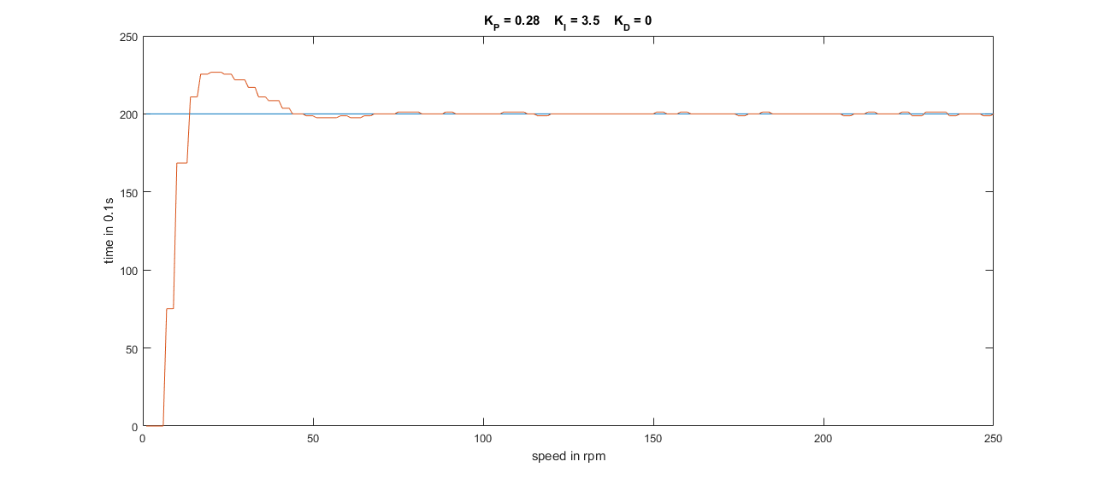
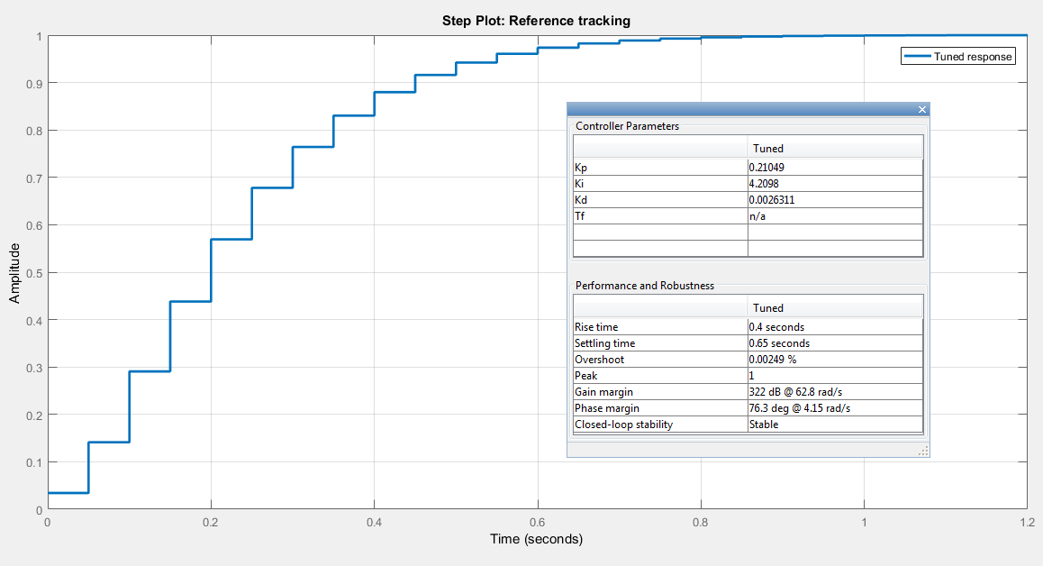
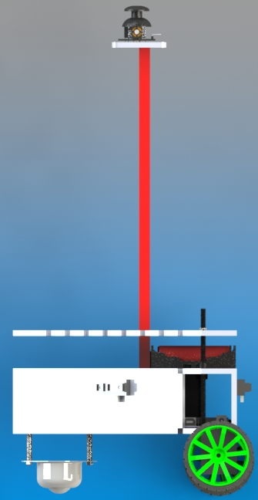
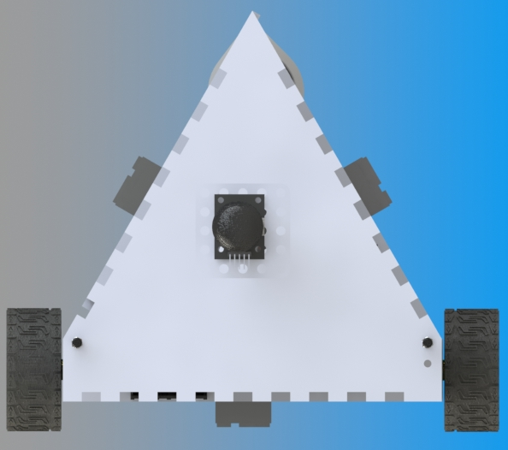
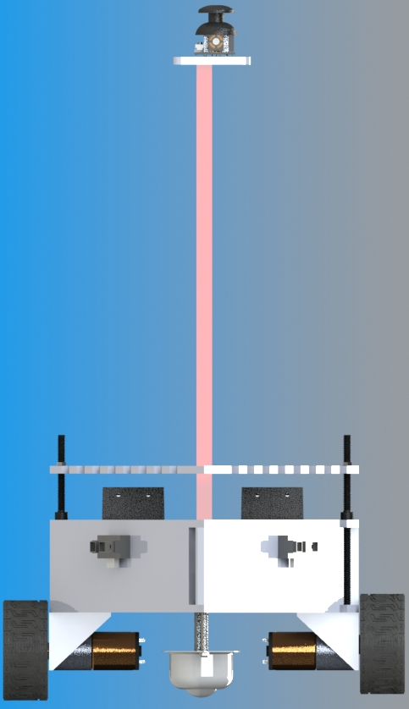
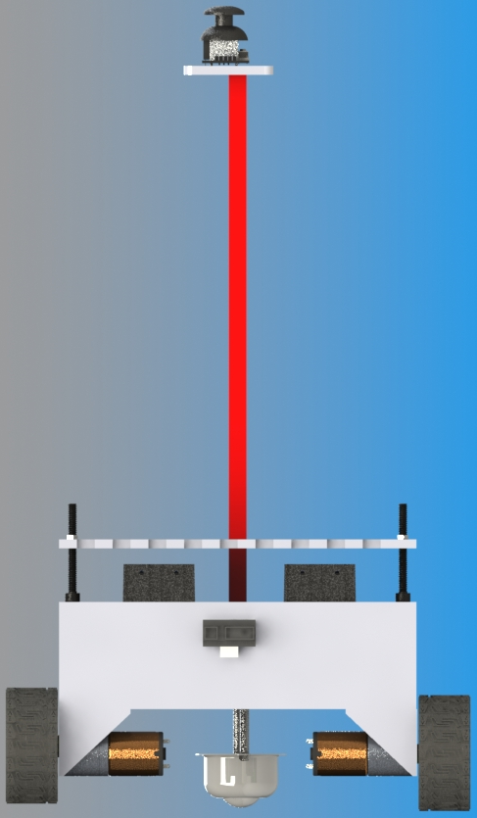
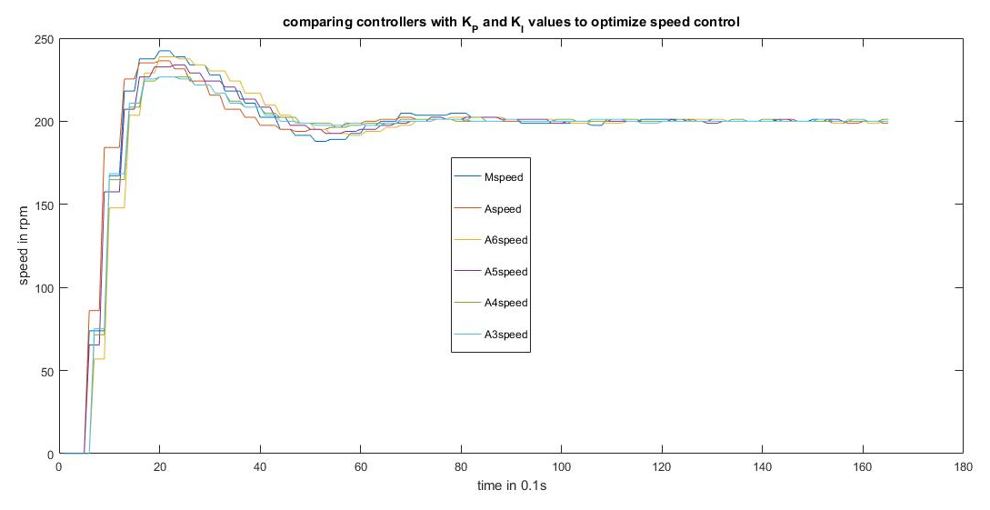
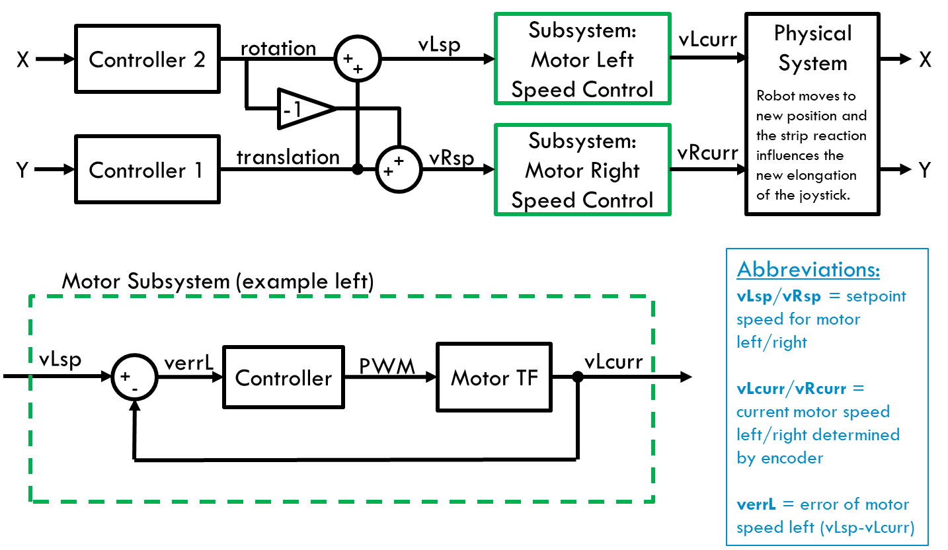
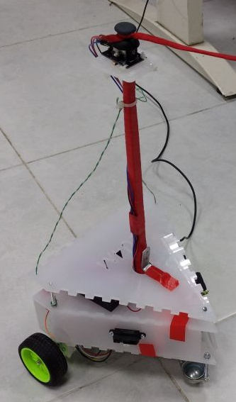
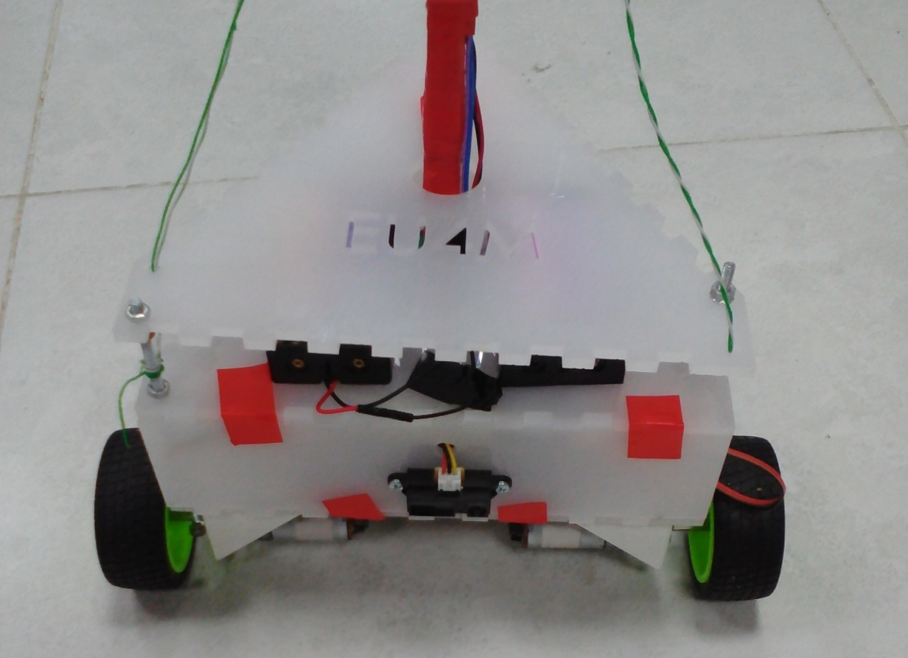
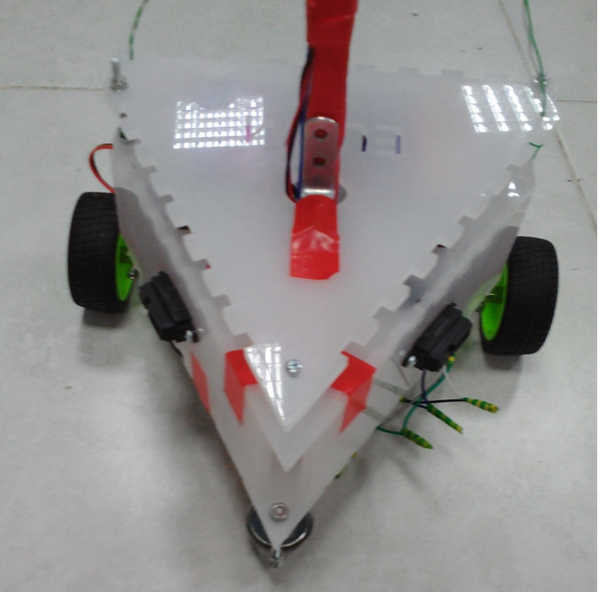
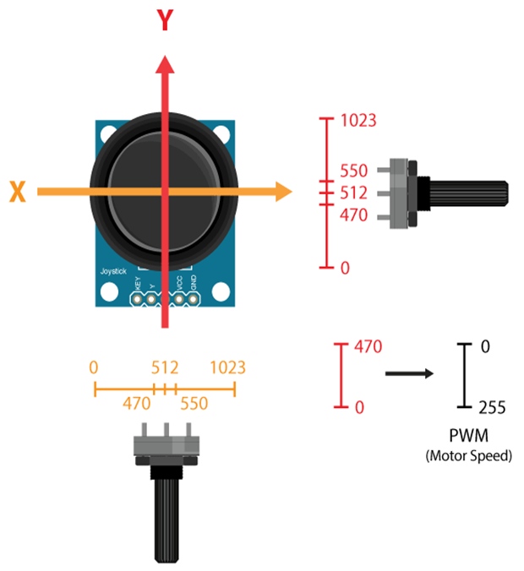
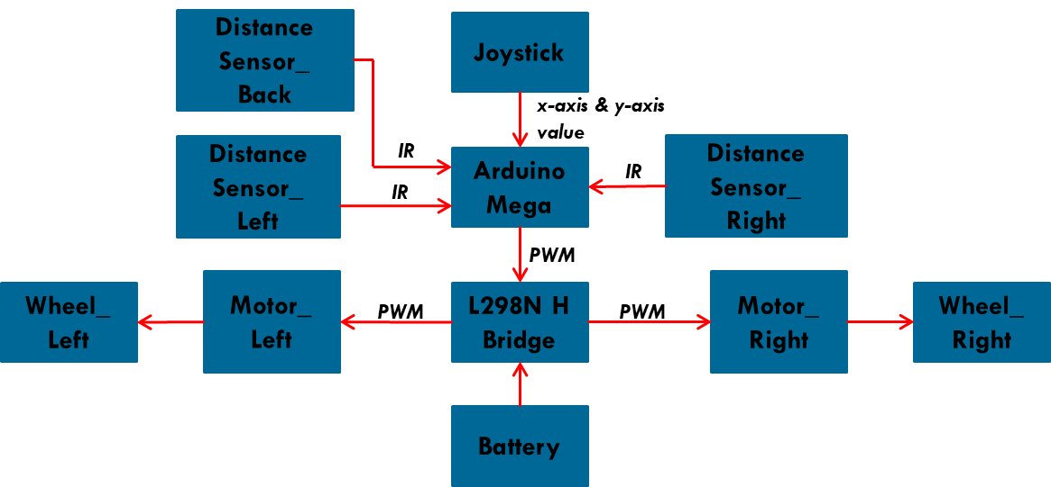

Design & Implementation of Robotic Infusion Stand.
Team Members:
Berit Adina Haendel; Mohd Saiful Akmal Bin Razali, Gabriel de Brito Silva, Hedaya Ali
b.adina@nu.edu.e;g m.saiful@nu.edu.eg g.silva@nu.edu.eg h.raafat@nu.edu.eg
Supervised by
Dr. Ahmad Taher Azar , ENG. Hossam Hassan ahmad_t_azar @ieee.org Hhassan@nu.edu.eg
ABSTRACT
Introduction & MOTIVATION
EXPERIMENTAL RESULTS
Infusion Stand is one of the medical supportive tools in the field of biomedical that assist in holding and carrying medications to patients via intravenous injections. Mobilization of Infusion Stand from a place to another place is necessary not only for the patients itself but also for the nurses. Therefore, this leads to not only uneasiness but also inconvenience for both parties. Moreover, the massive size of the Infusion Stand also bring a feeling of irritation as it causes difficulty during maneuvering the Infusion Stand. Therefore, in order to improve the existing situation and current Infusion Stand in the market, we come out with a proposal to design and implement a Robotic Infusion Stand. This robotic Infusion Stand comprises two motors with 2 wheels & a caster ball wheel, distance sensor, Arduino Mega as a microcontroller, joystick as an input of the robot and L298N H Bridge driver to control the rotation direction. The novelty of this robotic Infusion Stand is that, it will moving with an input given on the joystick by the strip reaction and try to follow the person who is in control of the strip. In order to make the robotic Infusion Stand stable, we implemented & fine tuned a Proportional-Integral-Derivative controller so that it able to follow the person & to avoid any obstacle.
Infusion Stand is that not only used extensively in hospitals, clinics, physical practices but also in the supportive care provided in the home. Normally, a conventional Infusion Stand consists of a stand alone metal structure which includes a rod, a chassis which typically equipped with 3, 4 or 5 legs with and a wheels & a hanger with one or more hooks at the upper part of the Infusion Stand. There are a lot of accessories that will be attached to the Infusion Stand such as bag of fluids like a water, medication & blood, urinary hooks, temporary pacemakers, patient handles & support trays. Meanwhile, robotic Infusion Stand is an improved version of existing Infusion Stand whereby it will moving with an input given due to the new elongation of the joystick, which influence by the strip reaction.
In summary, various controllers were used to tune angles servos ranging to get the best performance and stability. The graphs in fig5 presents best results tuned using the FAST PID (PIDF) controller
PIDF controller has been tuned to favor reference tracking, controller effort, input disturbance rejection and output disturbance rejection.
Table 1 presents our desired specifications for the system. The controllers are tuned in such away that they fall within the limits of set specification for rise time, settling time, overshoot and peak.
Figure 5 shows the result obtained. From the graph results, one ca conclude that we have no overshoots in any of the cases, our rise and settling times are all acceptable.
HARDWARE design :
The overall design of this Robotic Infusion Stand consists of 2 layers of base, wheels, a stand with a joystick. In order to maximize the availability of the space, we installed the Arduino Mega, L298N H bridge, breadboard on upper side of the first base. Below side of the first base is attached with a L-shape motor hubs, motors, 65mm wheels & caster ball wheel. On the second base, we installed fours 3.5V Li-Ion batteries to make sure that the center of mass is located above the pivot point. Then, a stand is placed on the first base connected through the second base with a hole in the middle of the base itself. Joystick is placed on the highest point of the Robotic Infusion Stand itself which is on the stand with a strip attached to the joystick.
OBJECTIVE
There are several objectives for this particular project which are described as follows:
To design and manufacture a Robotic Infusion Stand that tether to the patient and able to maneuver with a given direction.
To implement a PID controller in order to follow the person & to avoid any obstacle.
CONTROL CONCEPT
3(a)
3(b)
3(c)
3(d)
Figure 3: Hardware Design (CAD). (a) Front View. (b) Side View. (c) Back View. (d) Top View
Conclusion & Future Work
In conclusion, our Robotic Infusion Stand is working as what we desired. Our Robotic Infusion Stand is able to maneuver with an input given on the joystick by the strip reaction and try to follow the person who is in control of the strip. Our Robotic Infusion Stand also able to avoid the obstacles. Besides, below are some recommendations that we can do for the future work:
Improving current joystick module with more quantity of potentiometers, so that we are able to get more accurate location.
Transforming the current joystick into an advanced drive though automating the Robotic Infusion Stand.
Implement an alarm system to alert the patients & nurses when the bag of fluids were emptied.
Improving the drive of motors between the transmitting side & receiving side of Robotic Infusion Stand.
Optimize obstacle detection with a wider range.
Implement a non human intervention whereby the Robotic Infusion Stand is not directly tether to the patient.
4(b)
Figure 4: Hardware Design (Real). (a) Side View. (b) Back View. (c) Front View. (
Figure 1: Evolvement of automation control systems
Abbreviations:
vLsp/vRsp = setpoint speed for motor left/right
vLcurr/vRcurr = current motor speed left/right determined by encoder
verrL = error of motor speed left (vLsp-vLcurr)
SCHEMATIC DIAGRAM
4(a)
4(c)
Concept of Joystick
Joystick is theoretically made up of two potentiometers which are connected to the analog inputs of the microcontroller (Arduino Mega). This joystick will have values from 0 to 1023.
Value of the joystick on both axes (x-axis & y-axis) is 512 when the joystick stays in the Centre position.
Acknowledgements
Special thanks to the course instructor Dr Ahmad Taher Azar for his valuable effort during the course and for his guidelines to prepare this project.
Figure 5: Concept of Joystick
Figure 2: Schematic diagram of Robotic Infusion Stand

